Slide 1
California State University, Sacramento Computer Science Department
CSC 179 - Software Testing and Quality Assurance
Summer 2022
Introduction:
System Engineering,
Software Engineering , Process and CMM Models
Lecture # 1

Slide 2
Software
Software
includes computer programs, associated software documentation and data of a system
Software Products
Generic/stand alone systems
Sold on the open market (shrink wrapped)
Customized
Commissioned by a customer

Slide 3
System
System
A collection of elements related in a way that allows a common objective to be accomplished.
In computer systems, these elements include hardware, software, people, facilities, process.
Complex systems
include subsystems, which are also systems. (Software System Engineering deals with software subsystem)

Slide 4
System Elements
Elements of a system
are not just hardware but can also include software, and can even include people, facilities, policies, documents and databases.
System
an integrated set of elements that accomplish a defined objective. The objective is what is to be created.

Slide 5
System Elements
Subsystem
is a system, except that it normally will not provide a useful function on its own, it must be integrated with other subsystems (or systems) to make a system.
Components
are elements that make up a subsystem or system.
Parts
are elements on the lowest level of the hierarchy

Slide 6
Types of Systems
Open systems
Closed systems
Conceptual systems
Physical systems
Static systems
Dynamic systems

Slide 7
Types of Systems
Open Systems Examples
………..
Closed Systems Examples
………..
Conceptual Systems Examples
………..

Slide 8
Types of Systems
Physical Systems Examples
………..
Static Systems Examples
…………..
Dynamic Systems Examples
……………….

Slide 9
System Engineering
System Engineering
Concentrate not only on the software but rather on the system as a whole and its elements…
SE occurs as a result of a process called system engineering.

Slide 10
System Engineering
System Engineering
A logical process of activities which transforms a set of requirements arising from a specific mission objective into a full description of a system which fulfills the objective in an optimum way.
It ensures that all aspects of a project have been considered and integrated into a consistent whole.

Slide 11
System Engineering
The system engineering discipline covers the development of total systems, which may or may not include software.
Systems engineers
focus on transforming customer needs, expectations, and constraints into product solutions and supporting those product solutions throughout the product life cycle.

Slide 12
System Engineering
Bring a unique focus:
Good system engineering begins with a clear understanding of the "world view" and progressively narrows until technical detail is understood.
A disciplined focus to the product.
A consistent vision of stakeholder's expectations independent of daily project demands. (cost, schedule, and performance)

Slide 13
Systems & Modeling
How system modeling is useful in system engineering?
Presents a visual presentation of the envisioned system.
Modeling allows engineers to assess the system
Evaluate system components in relationship to one another.
Simplify complexity
Examples of models: SCD, SFD, UML models, etc.
[Continued…]

Slide 14
Systems & Modeling
Build models to better understand the system being developed.
Build models of complex systems because it hard to comprehend such a system in its entirety.

Slide 15
Systems & Modeling
Four aims:
Assists engineers to visualize a system.
Allows engineers to specify the structure/behavior of a system.
Provides engineers with a template that guide in constructing systems.
Ensures documentation of the decisions that engineers make.

Slide 16
Systems & Modeling System Context Diagram (SCD)
System Context Diagram (SCD)
It establishes the information boundary between the system being implemented and environment in which the system operate.
It defines all external producers of information.
It defines all external consumers of information.

Slide 17
Systems & Modeling System Context Diagram (SCD)
Systems Context Diagrams are a fundamental early product that systems engineers need to develop to start the project with common understanding about the project
The primary goal of the system context diagram is to focus attention on external factors and events that should be considered in developing a complete set of systems requirements and constraints.

Slide 18
Systems & Modeling System Context Diagram (SCD)
The SCD is often viewed as a block diagram, showing a system, and its inputs and outputs from/to external factors.
It is the highest-level view of a system.
SCDs are considered an excellent communication tools with stakeholders.

Slide 19
Systems & Modeling System Context Diagram (SCD)
Used early in the project lifecycle to develop and document an agreement on the scope of the system requirements.
An SCD does not provide information about the sequence or timing of processes.
Therefore, it should not be confused with a flowchart or process flow diagram.

Slide 20
Modeling – “Structured Approach”
Process
specification
(PSPEC)
Data Object
description
ERD
Data dictionary
DFD
STD
Control Specification (CSPEC)
Fig. 1

Slide 21
Modeling - Object-Oriented Approach
Function
Class diagram
Object diagram
Use case diagram
Activity diagram
Data
Object
Behavior
State-chart diagram
Interaction diagram
Fig. 2

Slide 22
System Thinking
System thinking is a method of critical thinking by which one can analyze relationship between system’s parts to understand the situation for better decision making.

Slide 23
System Thinking
Characteristics of System Thinking:
Shift perspective from Parts to Whole
System’s properties cannot be reduced to part’s properties. System’s properties cannot be applied to individual parts. Thinking of the whole system.
Shift perspective from Objects to Relationship
Parts interact with each other to create relationship. Objects build the network.
Shift perspective from Structures to Process
Continual flow of things in system is more important than configuration or object structure.

Slide 24
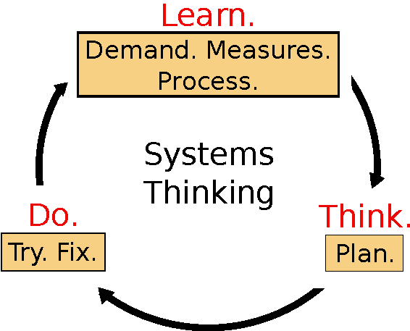
System Thinking
System Thinking is an approach to work that considers the whole system of which the work is a part and provides tools to map out and improve that system.[1]
Fig. 3

Slide 25
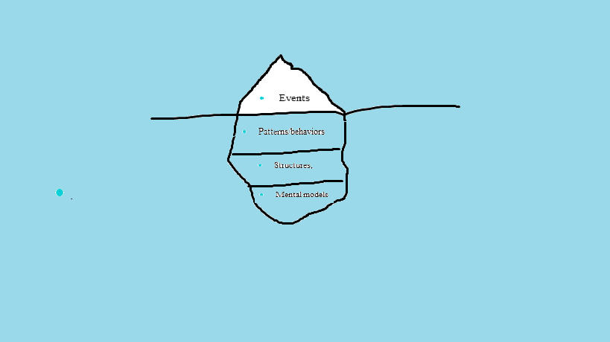
Iceberg Model
Iceberg is used as an analogy to represent underlying structures generating perceived events and issues
Fig. 4

Slide 26
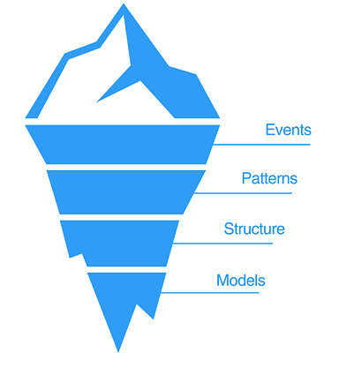
Iceberg Model
Four basic levels to situations:
Events : components & actions observable to us
Discrete activities or facts about the state of things in system
What happens or what we see
Patterns of Behavior: describes trends over time
Pattern of recurrence of events
What is happening ? What is changing?
Allows to anticipate, plan & forecast
Fig. 5

Slide 27
Iceberg Model
System Structure: parts interrelated to influence pattern
Composed of cause-and-effect relationships, connections between patterns.
Reveals underlying structure of problems.
Mental Models: supports everything through beliefs, values, assumptions
Thinking that creates structures that manifest in pattern of events.
Assumptions and beliefs that drive behavior and keeps the structure from doing what it does.

Slide 28
System Development and Process?
(Webster)
A system of operations in producing something; a series of actions, changes, or functions that achieve an end or a result
(IEEE)
A sequence of steps performed for a given purpose

Slide 29
What is a Software Process?
(SEI)- A set of activities, methods, practices, and transformations that people use to develop and maintain software and the associated products (e.g., project plans, design documents, code, test cases, and user manuals).
As an organization matures, the software process becomes better defined and more consistently implemented throughout the organization.
Software process maturity is the extent to which a specific process is explicitly defined, managed, measured, controlled, and effective.

Slide 30
Process Principles
Prescribes all major activities
Uses resources, within a set of constraints, to produce intermediate and final products.
May be composed of sub-processes.
Each activity has entry and exit criteria.

Slide 31
Process Principles
Activities are organized in a sequence.
Has a set of guiding principles to explain goals.
Constraints may apply to activity, resource or product.

Slide 32
Design Thinking
Definition:
Design Thinking represent a set of cognitive, strategic and practical processes by which design concepts are developed.[2]
It helps to identify the problem of users, which leads to generate an idea and then tackle a problem by testing range of ideas and gathering feedback.

Slide 33
Design Thinking
Stages of Design Thinking
Empathize – conduct research to understand users.
Define – combine research and observe users’ problems.
Ideate – generate innovative and creative ideas.
Prototype – build a model based upon ideas.
Test – return it to users for feedback.
Implement – start implementing the idea.
Source

Slide 34
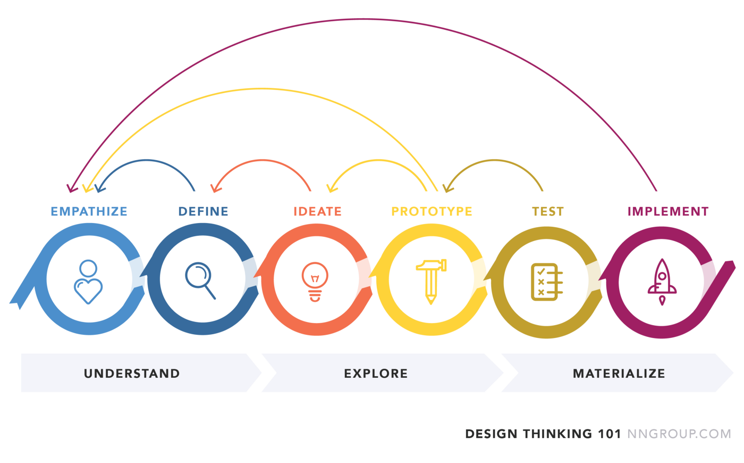
Stages of Design Thinking
Fig. 6 [3]

Slide 35
Benefits of Design Thinking
It helps to view different perspective of people and often leads to creative and innovative ideas to tackle a problem.
Feedback from users in early stage before implementation results in saving of money, resources and time.

Slide 36
System Thinking and Design Thinking
Similarities
Both system thinking and design thinking includes the process tackling the problems over the course of learnings from feedbacks.
Differences
System thinking is about breaking systems down to their components to understand the bigger picture while design thinking is about creating and building.[4]

Slide 37
System Thinking and Design Thinking
Similarities
Critical thinking is a key component for system as well as design thinking.
Differences
System thinking has wide spectrum of focus because of considering different strategies, while design thinking has narrow spectrum due to focuses only on user focused needs.[4]

Slide 38
Capability Maturity Models CMM & CMMI
Capability Maturity Model (CMM) & Capability Maturity Model Integration (CMMI)
Developed by SEI – (Software Engineering Institute at Carnegie Mellon)
The CMMI project is sponsored by the U.S. Department of Defense (DoD) and the National Defense Industrial Association (NDIA).

Slide 39
Capability Maturity Model (SW-CMM)
Developed in 1987 by the Software Engineering Institute (SEI) at Carnegie-Mellon University under the sponsorship of DARPA
Described in the book Managing the Software Process in 1989 by Watts Humphrey
Published as a separate document: Capability Maturity Model for Software in 1991

Slide 40
Why Capability Maturity Models
The Capability Maturity Model Integration(CMMI) is a process and behavioral model that helps organizations streamline process improvement and encourage productive, efficient behaviors that decrease risk in software, product, and service development.[5]

Slide 41
Capability Maturity Models – CMM - Levels
Initial Level (Level 1)
Characterized as ad hoc, and occasionally even chaotic
Repeatable (Level 2)
Basic project management processes are established to track cost, schedule, and functionality.
The necessary process discipline is in place to repeat earlier successes on projects with similar applications.

Slide 42
CMM – Levels
Defined (Level 3)
The software process for both management and engineering activities is documented, standardized, and integrated into a standard software process for the organization.
Managed (Level 4)
Detailed measures of the software process and product quality are collected.
Both the software process and products are quantitatively understood and controlled.

Slide 43
CMM - Levels
Optimized (Level 5)
Continuous process improvement is enabled by quantitative feedback from the process and from piloting innovative ideas and technologies.

Slide 44
CMMI Maturity Levels
5
Optimizing
Focus on process improvement
4
Quantitatively
Managed
Process measured and controlled
3
Defined
Process characterized for the organization and is proactive
2
Managed
Process characterized for projects and is often reactive
1
Performed
Process unpredictable, poorly controlled and
reactive
Fig. 5

Slide 45
References
https://accu.org/journals/overload/19/103/sedge_1975/
https://en.wikipedia.org/wiki/Design_thinking
https://medium.com/@bhmiller0712/what-is-design-thinking-and-what-are-the-5-stages-associated-with-it-d628152cf220
https://medium.com/swlh/design-thinking-vs-systems-thinking-ca13caa17557#:~:text=Design%20thinking%20focuses%20on%20synthesis,to%20understand%20the%20bigger%20picture.
https://www.cio.com/article/274530/process-improvement-capability-maturity-model-integration-cmmi-definition-and-solutions.html

Slide 46
Questions?

